Slide 1

EXPLORE - UNDERSTAND - EXECUTE
Options : Credit Spreads
09 April’26
Disclaimer
Disclaimer: Investment in securities market are subject to market risks, read all the related documents carefully before investing. Brokerage will not exceed the SEBI prescribed limit. Options trading involves high risk and is not suitable for all investors.
Private & Confidential. Please do not circulate.

Slide 2

Presenter Hitesh Chotalia
Market Experience : 26 Years
Technical Market Strategist : Share khan
Asia Pacific Equity Research : Citi Global Markets
Technical Market Strategist : Centrum Broking
Product Head : Ignite – Sharekhan Education
Sr VP : Motilal Oswal : Head School Of Trading & Investing
Head Education : Fin Learn Academy
Media Appearance : CNBC & NDTV Profit

Slide 3
Debit - Credit
Risk = Limited
Reward : Unlimited
Risk = Unlimited
Reward : Limited
Risk = Limited
Reward : Unlimited
Risk = Unlimited
Reward : Limited
Pay = Debit
Pay = Debit
Receive = Credit
Receive = Credit
Price Up
Call Up
Put Dn
Put Up
Call Dn
+ CE
- PE
Price Down
- CE
Buy
+ PE
Sell
Buy
Sell
Notes:
Add source, change framing

Slide 4

Overview of Today’s Webinar
Options : Debit / Credit
Options Credit Strategies
Bull Put Spread
Bear Call Spread
• When to use Bull Put Spread/ Bear Call Spread
• Strategy construction and payoff understanding
• Ideal market conditions for each spread
• Risk, reward & breakeven analysis
• Common mistakes traders make with directional spreads
Notes:
Add source, change framing

Slide 5
Moneyness: Out Of Money (CE : OTM)
OTM 4
OTM 3
OTM 2
OTM 1
OTM 4
OTM 3
OTM 2
OTM 1
Call Option
935
930
925
920
O
T
M
Expires @ 0.05 paisa
Above
CMP = ATM
ITM 1
ITM 2
ITM 3
ITM 4
ITM 1
ITM 2
ITM 3
ITM 4
HDFC BANK CMP = 916= ATM = 915
Below
910
905
900
895
HDFC Bank Strike Interval = 5
Disclaimer: Stock/Index, prices, and strikes used are for illustration purposes only and should not be considered recommendation
Notes:
Add source, change framing

Slide 6
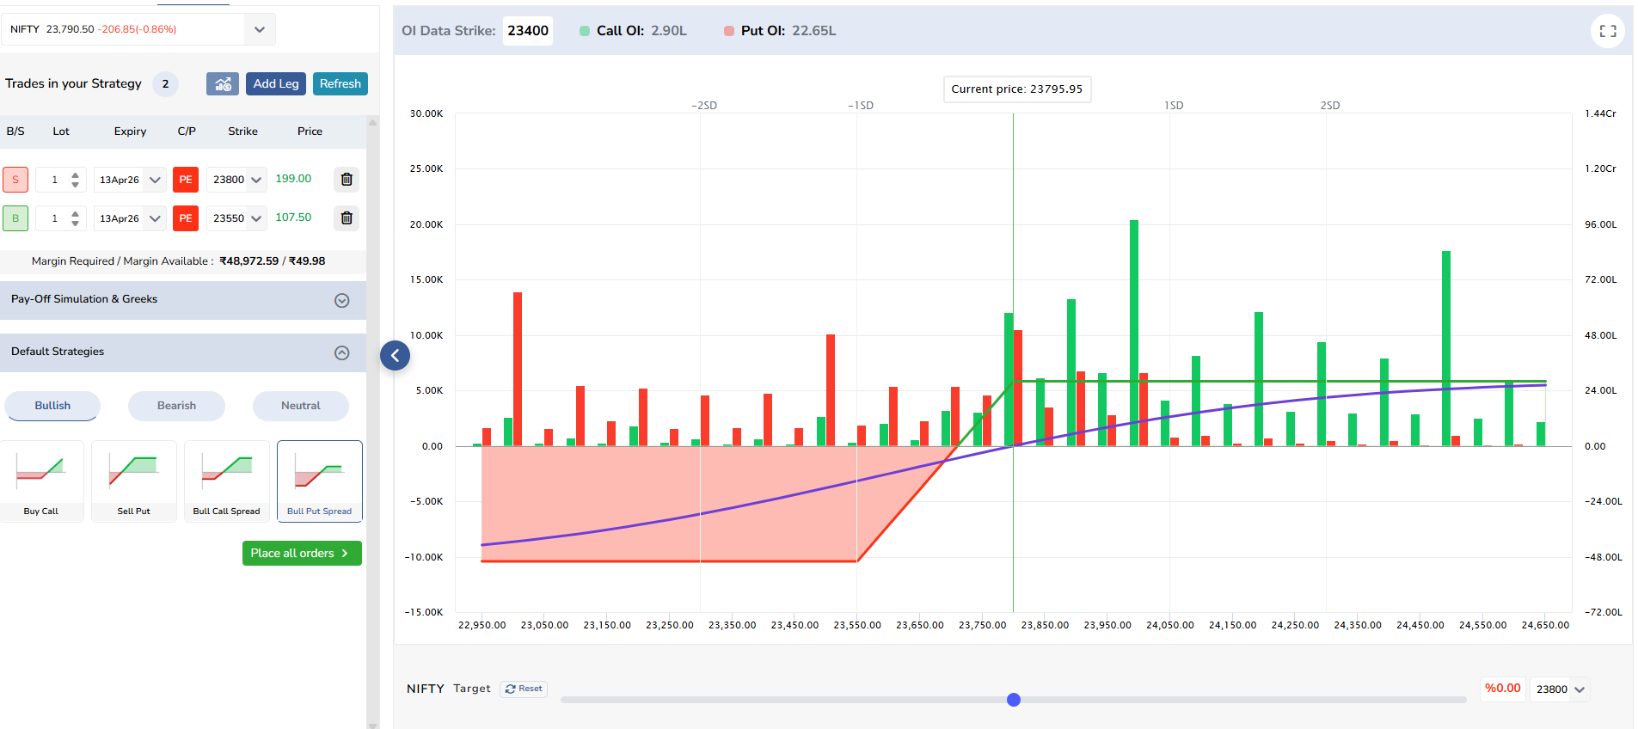
Bull Put Spread: Payoff Chart
Disclaimer: Stock/Index, prices, and strikes used are for illustration purposes only and should not be considered recommendation
Notes:
Add source, change framing

Slide 7
Moneyness: Out Of Money (PE : OTM)
ITM 4
ITM 3
ITM 2
ITM 1
OTM 4
OTM 3
OTM 2
OTM 1
Put Option
935
930
925
920
Above
CMP = ATM
OTM 1
OTM 2
OTM 3
OTM 4
OTM 1
OTM 2
OTM 3
OTM 4
HDFC CMP = 916= ATM = 915
Below
910
905
900
895
O
T
M
HDFC Bank Strike Interval = 5
Disclaimer: Stock/Index, prices, and strikes used are for illustration purposes only and should not be considered recommendation
Notes:
Add source, change framing

Slide 8
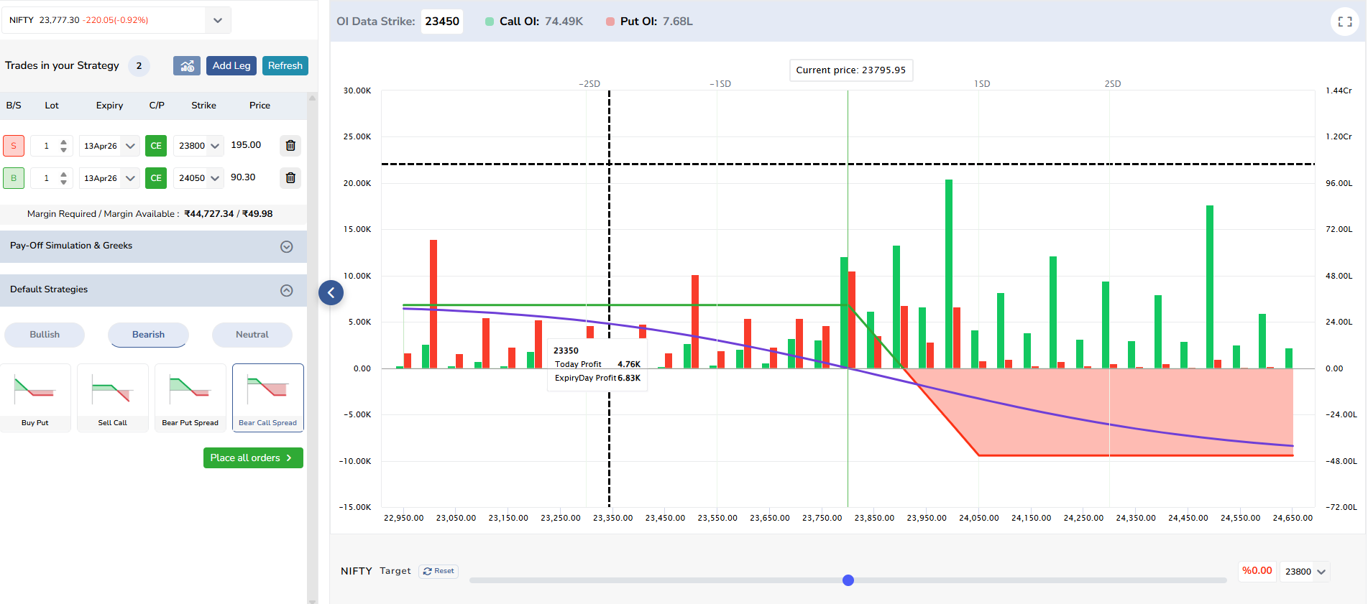
Bear Call Spread: Payoff Chart
Disclaimer: Stock/Index, prices, and strikes used are for illustration purposes only and should not be considered recommendation
Notes:
Add source, change framing

Slide 9
Q & A
Notes:
Add source, change framing

Slide 10
Disclaimer
Investments in the securities market are subject to market risks,read all the related documents carefully before investing. Brokerage will not exceed the SEBI prescribed limit.
Any video/image/text content is for educational and informational purposes only and does not constitute financial
advice. Please do your own research or consult a qualified financial advisor before making any investment or trading decisions. Trading in stock markets involves risk of loss.
South Asian Stocks Ltd. : NSE Member Code 09073, BSE
Member Code 6329, MCX Member Code : 55215 , NCDEX
Member Code : 1233 NSDL : IN-DP-474-2020 . SEBI Registration
No. INZ000164738
Compliance Officer: NSE, BSE,MCX,NCDEX,NSDL : Mr RK
Jain , 011-40409999 support@stocko.in
Registered Office:- 3rd Floor, Building No.5, Local Shopping
Complex, Rishabh Vihar, Near Karkarduma Metro Station. East
Delhi – 110092

