Slide 1

EXPLORE - UNDERSTAND - EXECUTE
Volatility
16th April’26
Disclaimer
This is for educational and informational purposes only and does not constitute financial advice. Refer - https://stocko.in/stocko-disclaimer/
Private & Confidential. Please do not circulate.

Slide 2

Presenter Hitesh Chotalia
Market Experience : 26 Years
Technical Market Strategist : Share khan
Asia Pacific Equity Research : Citi Global Markets
Technical Market Strategist : Centrum Broking
Product Head : Ignite – Sharekhan Education
Sr VP : Motilal Oswal : Head School Of Trading & Investing
Head Education : Fin Learn Academy
Media Appearance : CNBC & NDTV Profit

Slide 3
Volatility + Options
IV & Vega
Average True Range
Straddle Price
VIX India
VIX & Daily & Weekly Volatility Range
Notes:
Add source, change framing

Slide 4
Vega
Vega measures the sensitivity of an option’s price to changes in implied volatility (IV).
It shows how much the option premium will change when implied volatility changes by 1%.
Higher Vega means the option price is more affected by volatility changes.
Lower Vega means volatility has less impact on the option price.
Long options (buying calls or puts have positive Vega, meaning they benefit when volatility increases.
Short options (selling calls or puts) have negative Vega, meaning they benefit when volatility decreases.
Notes:
Add source, change framing

Slide 5
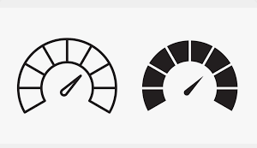
Implied Volatility
IV : It shows market forecast of how much the underlying might move in future
High IV : Options are expensive = Inflated
Low IV : Options are cheap = Deflated
In Option chain its in % age
Notes:
Add source, change framing

Slide 6
Vega :
Vega signifies for 1 % change in IV how much the option premium change
IV = 10 %
+ 1 %
= 11
Strike = 23500
Premium = 100
Vega = 8
Premium
108
Same if IV Drops
Notes:
Add source, change framing

Slide 7
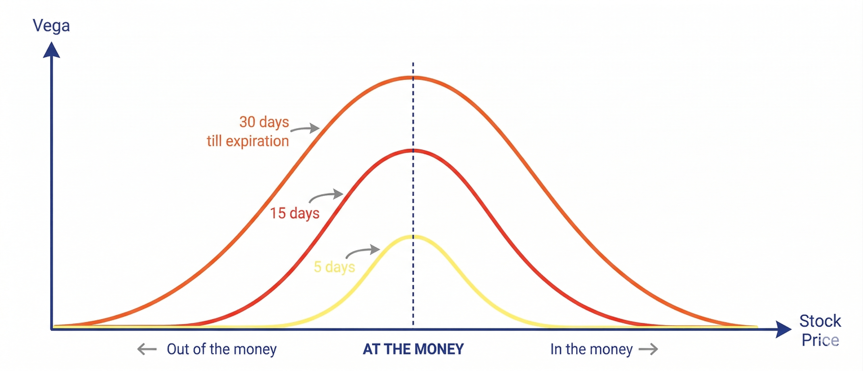
Vega : Example
Option premium = ₹120
Vega = ₹1.5
If Implied Volatility rises by 2%:
New premium change = ₹1.5 × 2 = ₹3
New option price ≈ ₹123
If Implied Volatility falls by 2%:
Option price ≈ ₹117
Simple Formula
Change in Option Price = Vega × Change in Implied Volatility
Example:
₹1.2 × 3% IV change = ₹3.6 change in option premium
Notes:
Add source, change framing

Slide 8
Vega :
Call Option & Put Option Have Same Vega
IV Increases = Price of both call option & put option rise
IV Decreases = Price of both call option & put option fall
IV Increase
IV Decreases
Option price increases
Good for option buyers
Option price decreases
Good for option sellers
Notes:
Add source, change framing

Slide 9
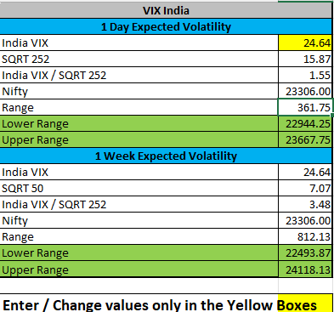
VIX : Hands On
Notes:
Add source, change framing

Slide 10
Q&A

Slide 11
Disclaimer
Investments in the securities market are subject to market risks,read all the related documents carefully before investing. Brokerage will not exceed the SEBI prescribed limit.
Any video/image/text content is for educational and informational purposes only and does not constitute financial
advice. Please do your own research or consult a qualified financial advisor before making any investment or trading decisions. Trading in stock markets involves risk of loss.
South Asian Stocks Ltd. : NSE Member Code 09073, BSE
Member Code 6329, MCX Member Code : 55215 , NCDEX
Member Code : 1233 NSDL : IN-DP-474-2020 . SEBI Registration
No. INZ000164738
Compliance Officer: NSE, BSE,MCX,NCDEX,NSDL : Mr RK
Jain , 011-40409999 support@stocko.in
Registered Office:- 3rd Floor, Building No.5, Local Shopping
Complex, Rishabh Vihar, Near Karkarduma Metro Station. East
Delhi – 110092

